Slide 1
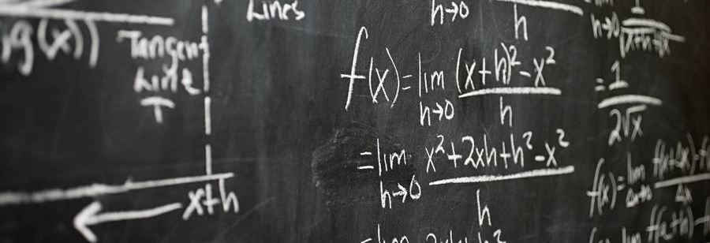
Predicting student math scores
Blanca T. Marmolejo

Slide 2


Agenda
Introduction
Target
Evaluation criteria
Model
Conclusion

Slide 3
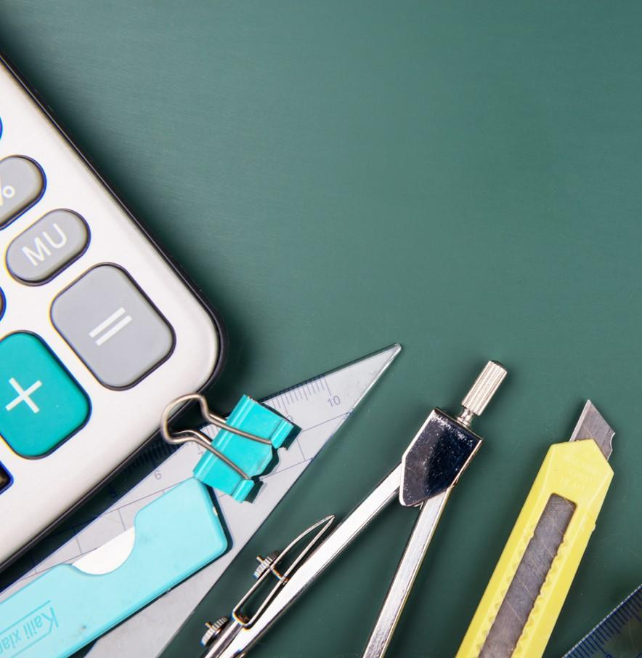
Introduction
To provide support for students early in the semester.
To improve end of year math test scores.
Enhance school scores

Slide 4
Target
Students
To start a presentation, go to the Slide Show tab, and select From Beginning.
School
To display Presenter view, in Slide Show view, on the control bar at the bottom left select the three dots, and then Show Presenter View.
Tutoring services
During your presentation, the speaker notes are visible on your monitor, but aren't visible to the audience.

Slide 5

Evaluation criteria
Model
Parental factors
Student characteristics
Environmental factors
Classify potential student grades
≥70
<70

Slide 6
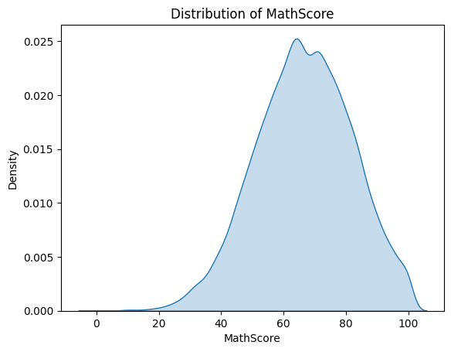
Evaluation criteria
Confirm target has normal distribution

Slide 7
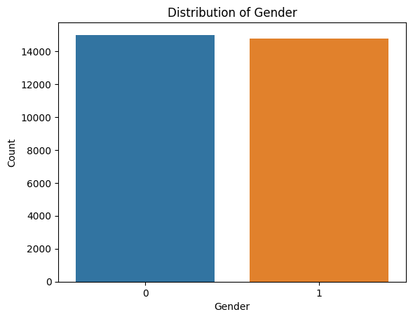
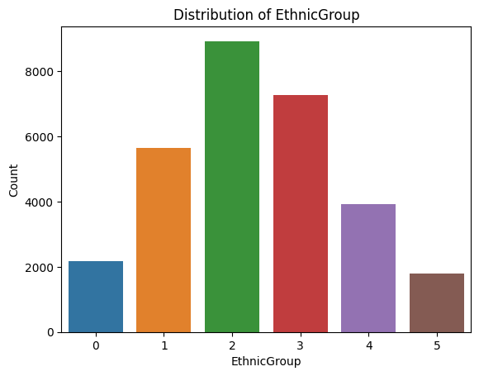
Evaluation criteria

Slide 8
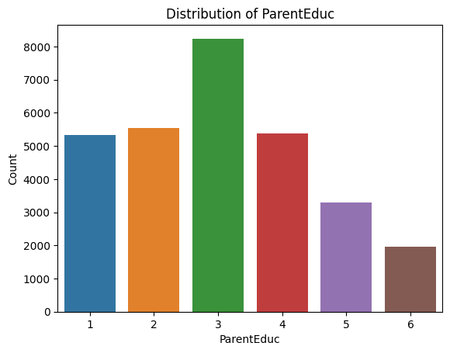
Evaluation criteria
some high school: 1
high school: 2
some college: 3
associate's degree: 4
bachelor's degree: 5
master's degree: 6
doctoral degree: 7

Slide 9
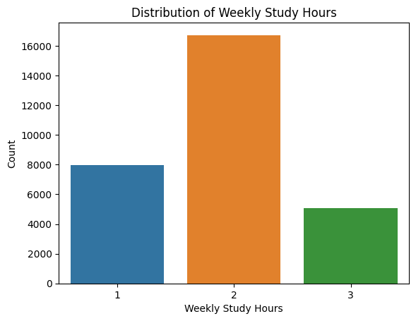
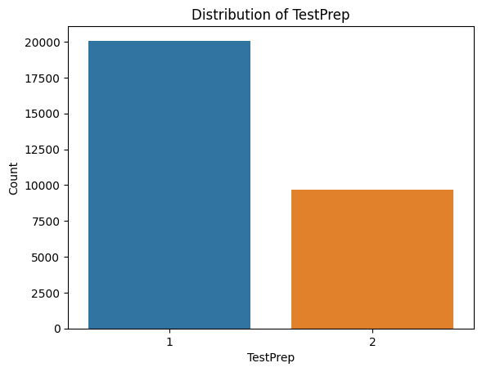
Evaluation criteria

Slide 10
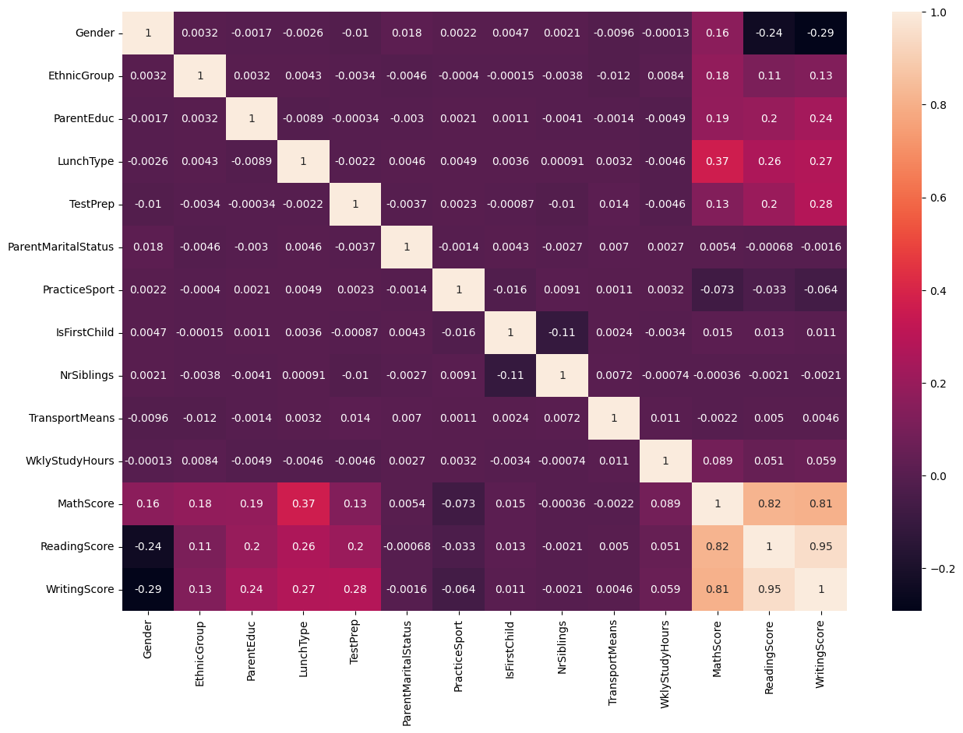
Evaluation criteria
No correlation for linear regression

Slide 11
Model
AUC Score
To start a presentation, go to the Slide Show tab, and select From Beginning.
Accuracy
To display Presenter view, in Slide Show view, on the control bar at the bottom left select the three dots, and then Show Presenter View.
Precision
During your presentation, the speaker notes are visible on your monitor, but aren't visible to the audience.
Recall
The Notes pane is a box that appears below each slide. Tap it to add notes.
0.743
0.668
0.609
0.703

Slide 12



Conclusion
With PowerPoint, you can create presentations and share your work with others, wherever they are. Type the text you want here to get started. You can also add images, art, and videos on this template. Save to OneDrive and access your presentations from your computer, tablet, or phone. ​

Slide 13

Thank you
Blanca T. Marmolejo

